Slide 1
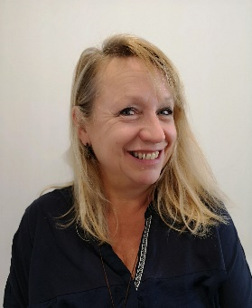
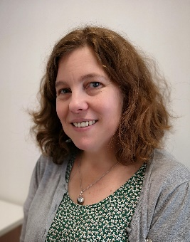
Support for Dyslexia and other Specific Learning Difficulties (SpLDs)
Karen Griffiths
Specialist Study Skills Tutor
Heather Sunderland
Specialist Study Skills Tutor
Student Support & Wellbeing

Slide 2
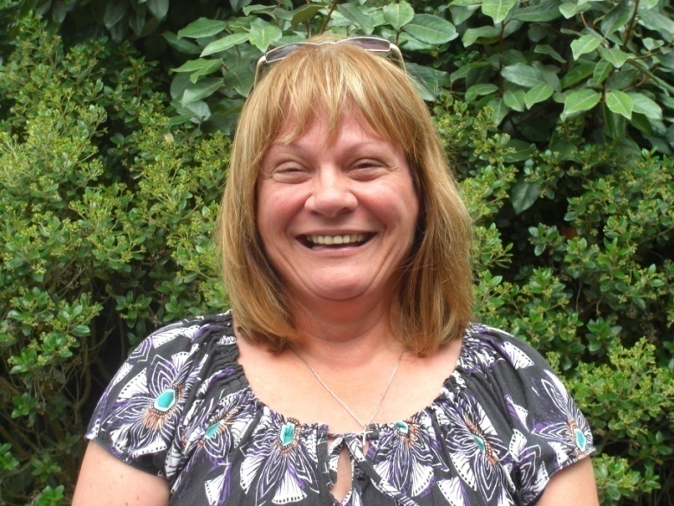
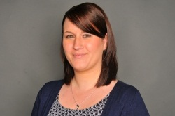
Disability & Inclusion Advice Service (DIAS)
Advice on eligibility for support, how to make a funding body application for ‘DSA’ – Disabled Students’ Allowances
For further information on how the DSA works, go to -
https://www.youtube.com/watch?v=71_L-ZdU0CU
Our Disability Advisers, Anne and Nikki, are available to answer any student queries.
Anne and Nikki, Disability Advisers
E-mail: disability@marjon.ac.uk

Slide 3
Support Available
for Plymouth Marjon University students
Plymouth Marjon University is fully committed to an inclusive teaching approach across all areas of learning.
The DSA funds:-
1:1 specialist study skills support
specialist equipment, software and training.
Inclusive Teaching approach
Equipment
1:1 support

Slide 4
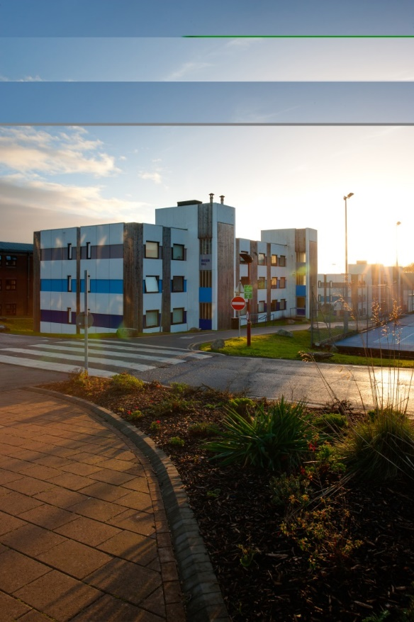
First steps
For enrolled students the university offers in-house Dyslexia screening which involves:
an informal discussion
previous learning needs
how we can best support your learning needs at university.

Slide 5
Next steps
The screening may highlight that a diagnostic assessment is required (we’ll signpost you).
If a student requires an Educational Psychologist assessment, then they are requested to pay a contribution towards the cost of the assessment.
If the Educational Psychologist’s assessment indicates Dyslexia (or another SpLD) then their report will include recommendations.

Slide 6
Specialist Study Skills Tutoring
Fully qualified and experienced tutors – with professional memberships and continuous annual training .
A regular one to one, online study skills session focussed on strategies to improve your study skills.
These strategies may include planning, organising, managing and reviewing your work.
Breaking down assignment tasks.
Using feedback to improve future work.

Slide 7
Getting in touch
Please feel free to contact one of the team for more information on Dyslexia or any other SpLD.
Our contact details are:
Student Support & Wellbeing – studentsupport@marjon.ac.uk
DIAS – disability@marjon.ac.uk
Heather Sunderland – hsunderland@marjon.ac.uk
Karen Griffiths – kgriffiths@marjon.ac.uk

